Slide 1










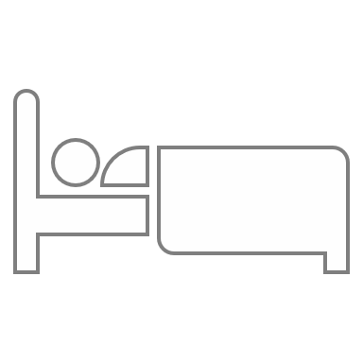

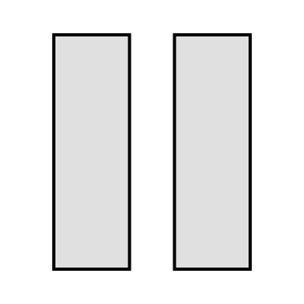


















Select a Task to focus on
4
Repeat for 4 rounds
Take a longer 30 minutes break and repeat
Set a timer and work continuously for 25 minutes
Take a productive 5 minutes break

